Slide 1
Journey to Standing Rock
Margaret Smith, Psy.D.
From October 17, 18 and 19, 2016

Slide 2
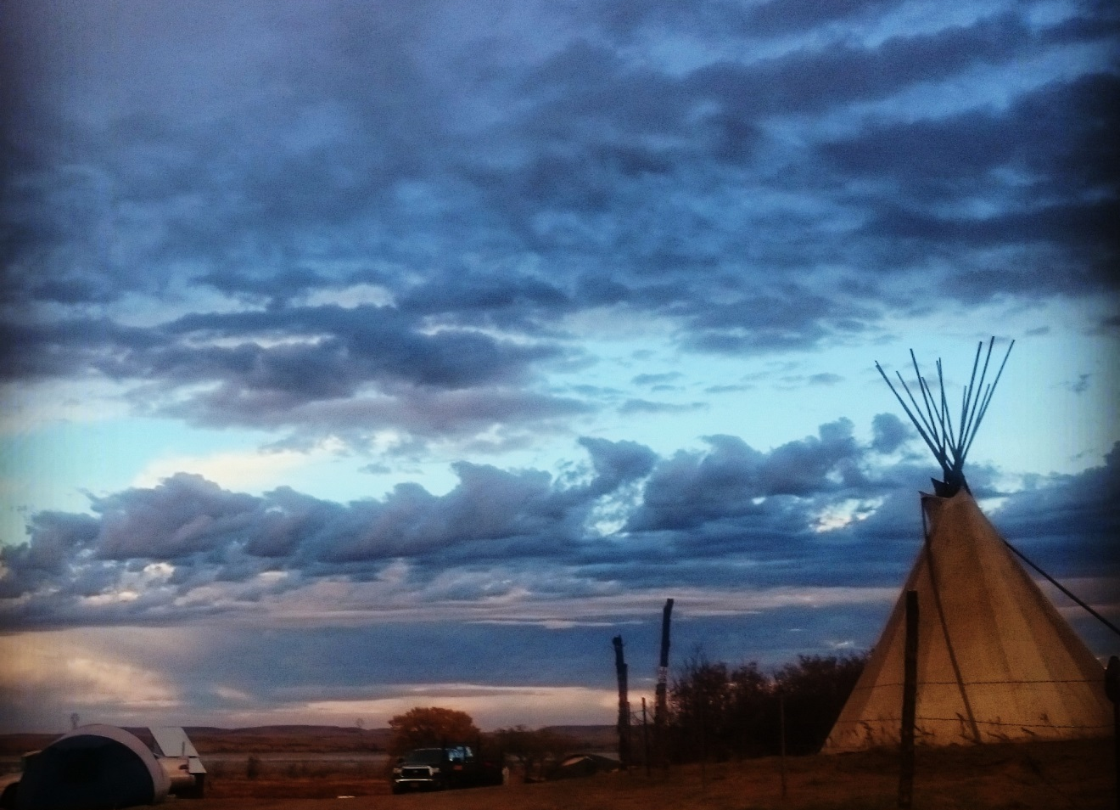
Sacred Stone Camp
This is located on Standing Rock Sioux Tribe Reservation Land, next to the Cannonball River

Slide 3
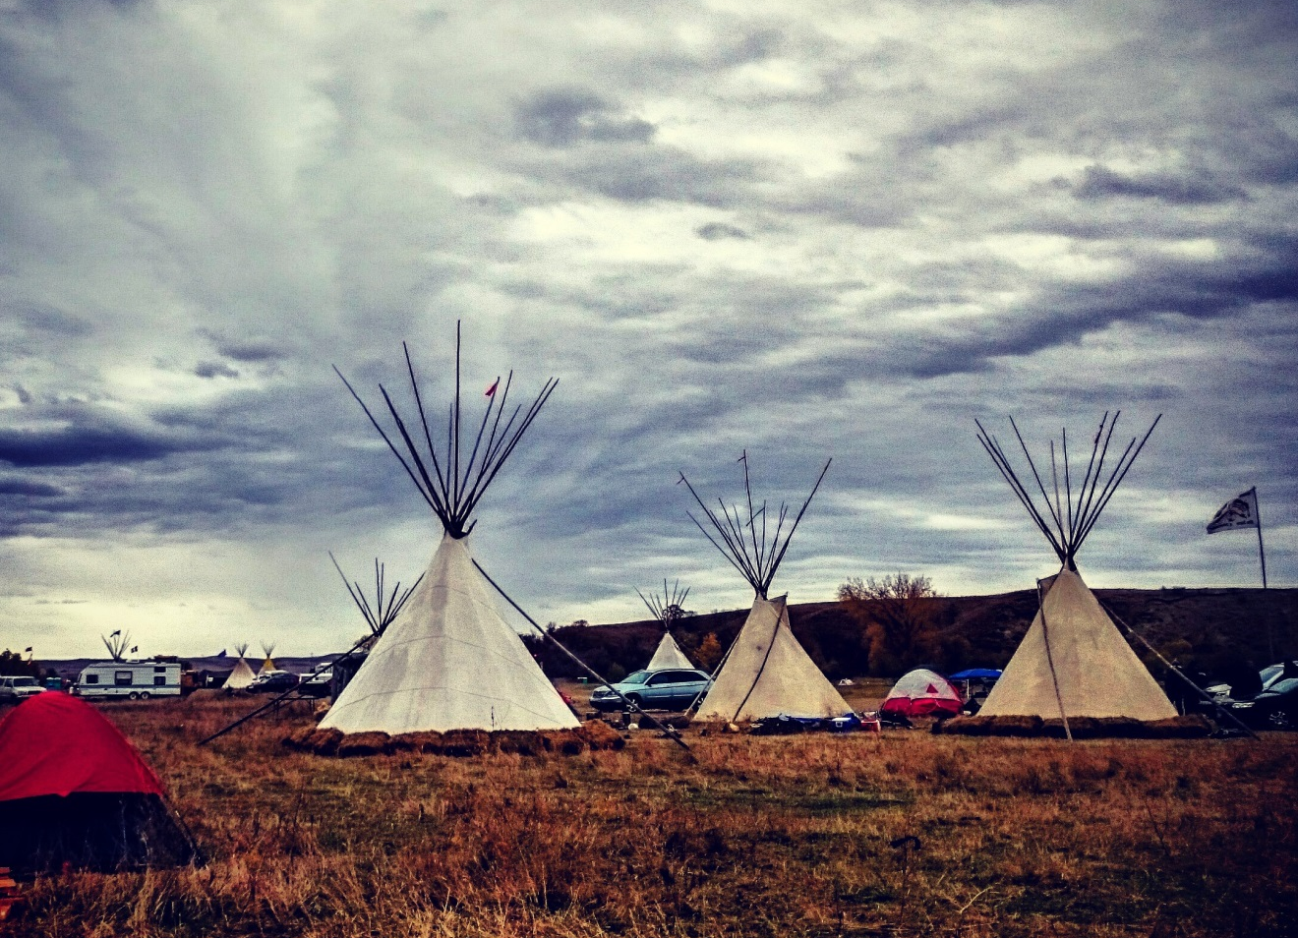
Oceti Sakowin
This camp is about a mile from Sacred Stone camp and is on Federal land that is the Army Corp of Engineer land

Slide 4
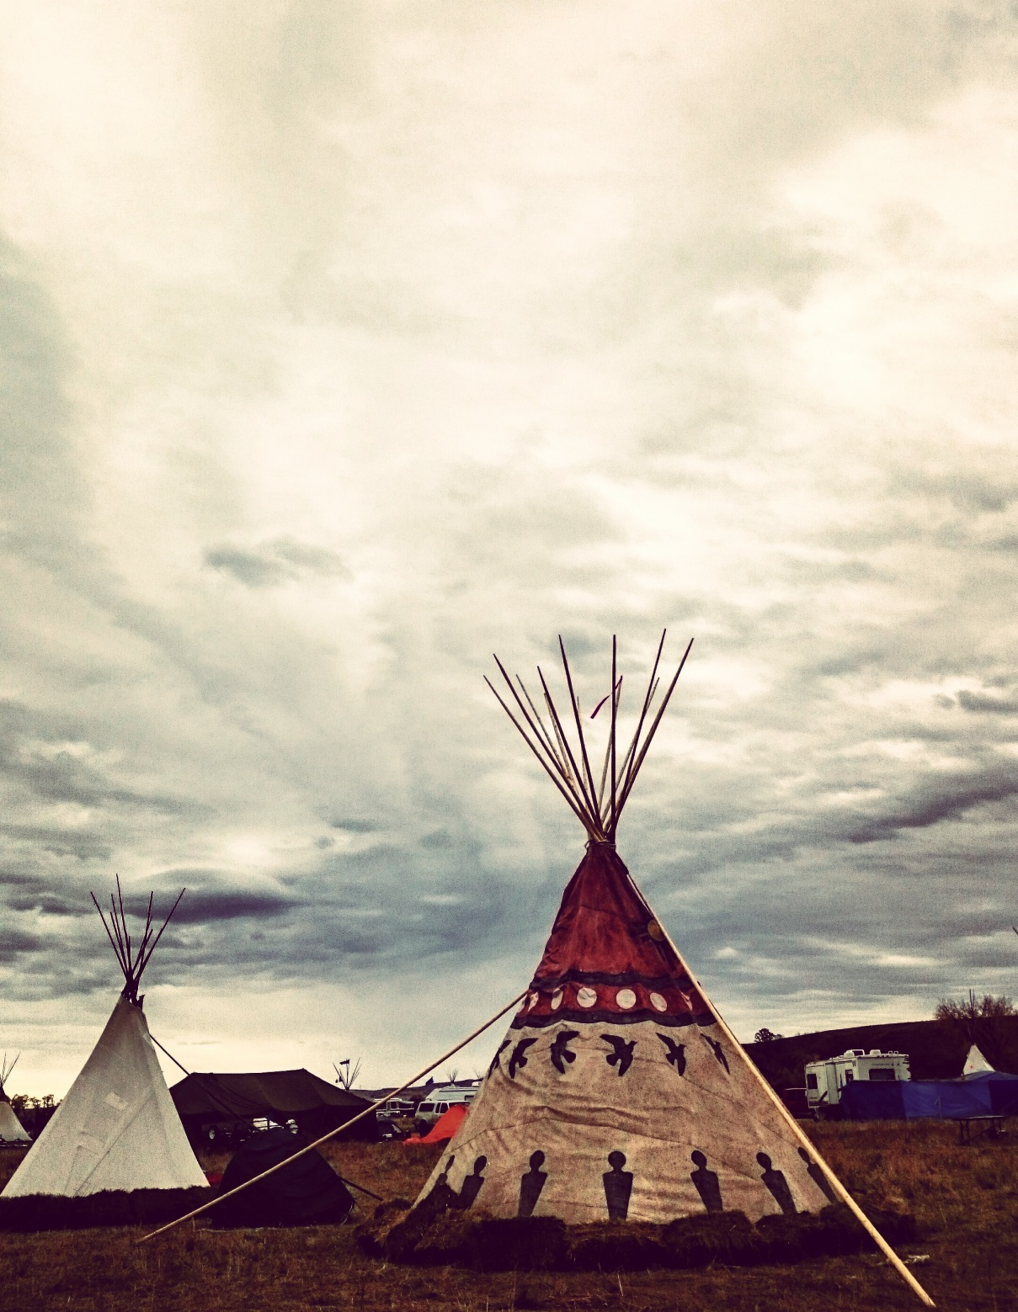

Slide 5
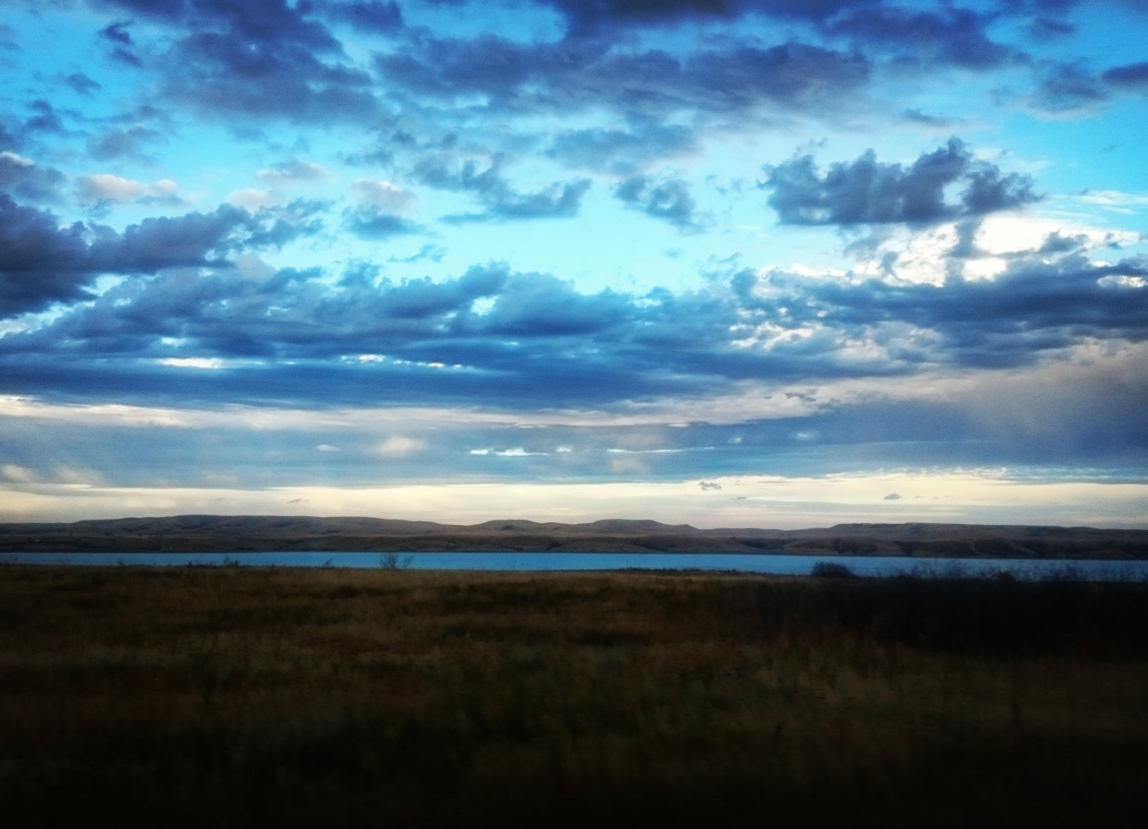
Cannonball River
This is what we are working together to protect.
We are Water Protectors

Slide 6
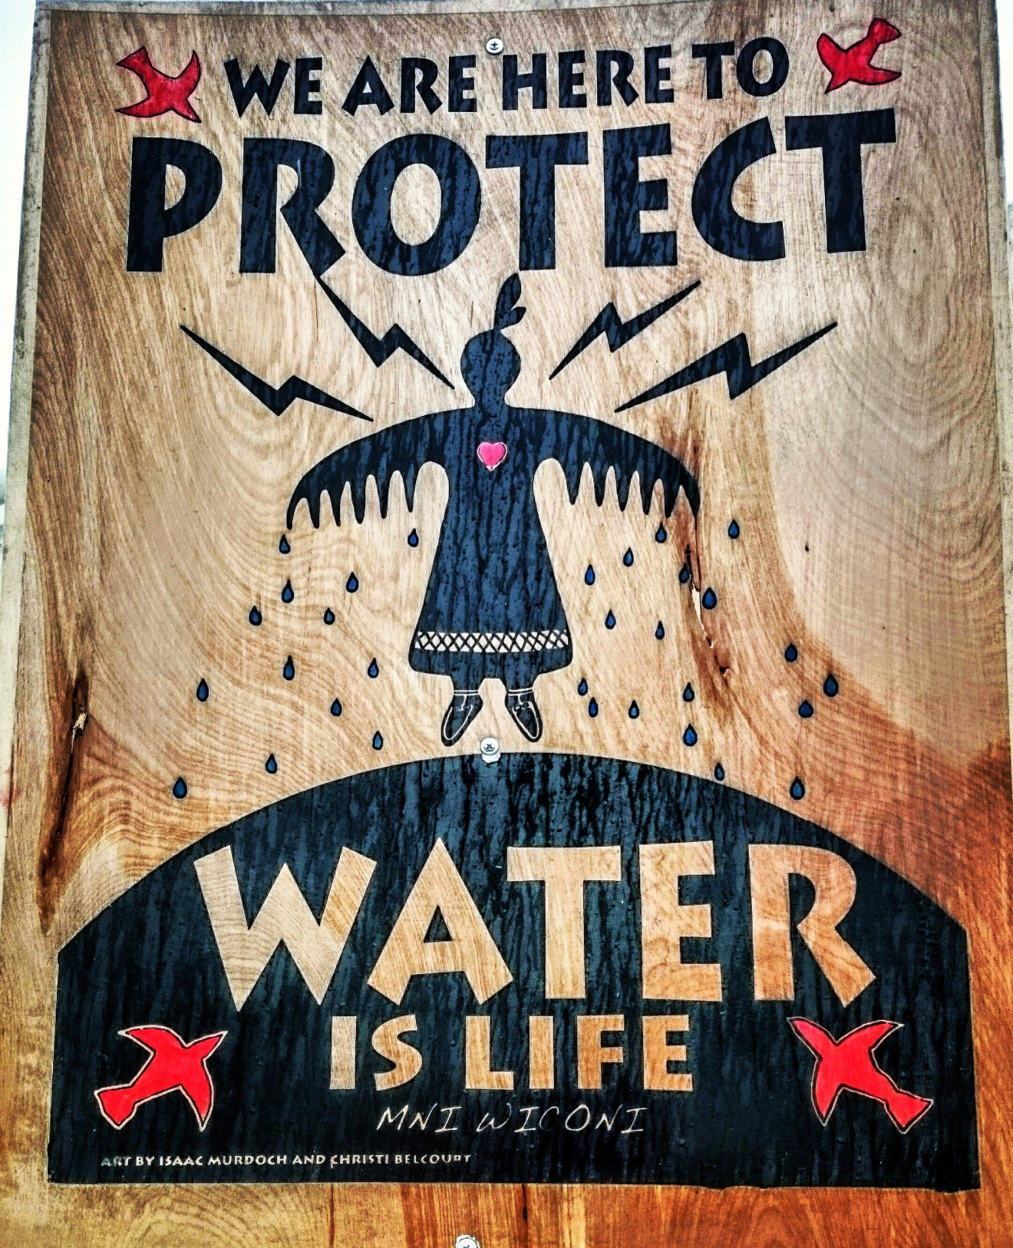

Slide 7
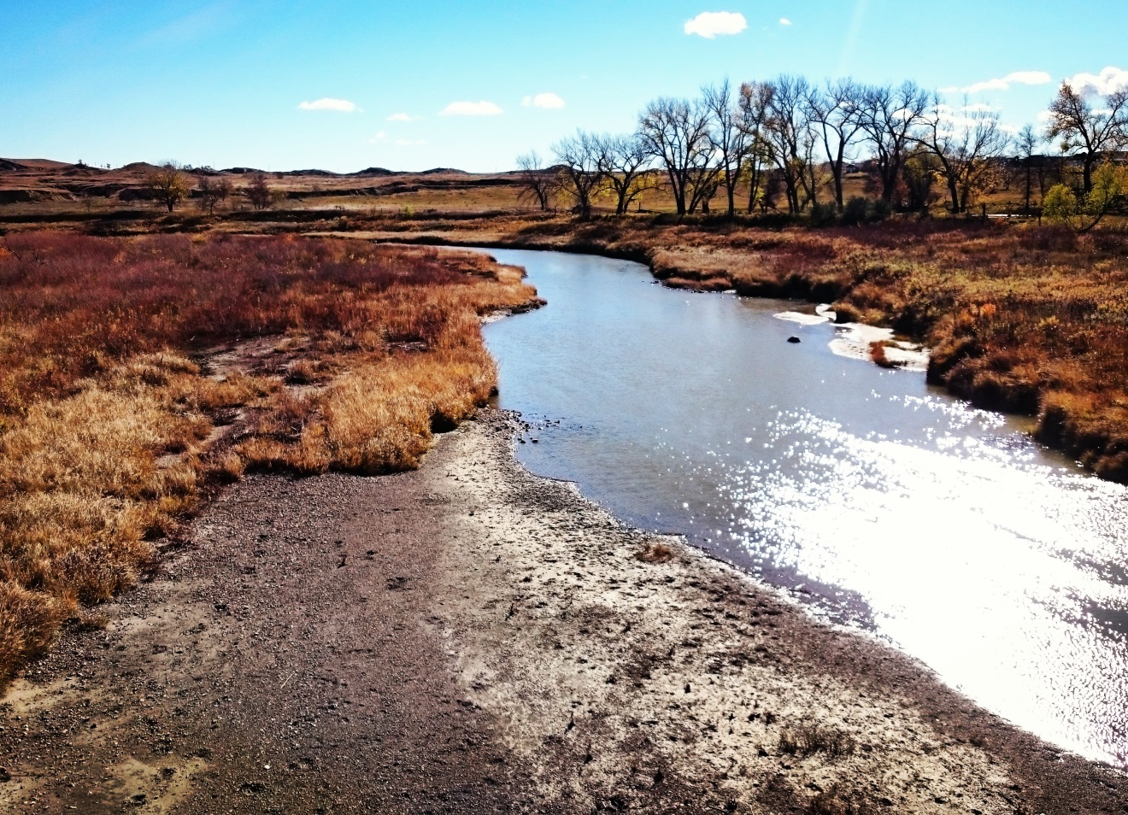
Cannonball River
The Dakota Access Pipeline intends to run beneath the Cannonball River. Should it leak, everything downstream of it will be contaminated.

Slide 8
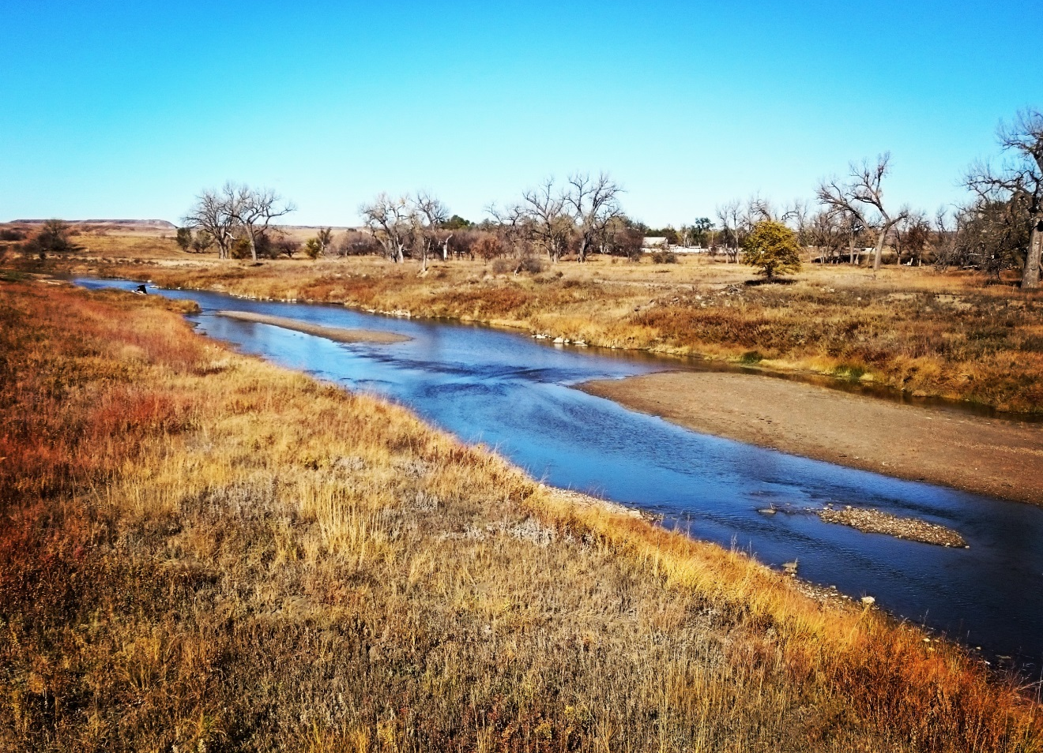
Cannonball River
The Cannonball River is a tributary of the Missouri River.
It is the sole water source for the Standing Rock Sioux Tribe

