Slide 1
Applied Learning University at Albany UAlbany Senate April 4th , 2016
Experience Transformation

Slide 2
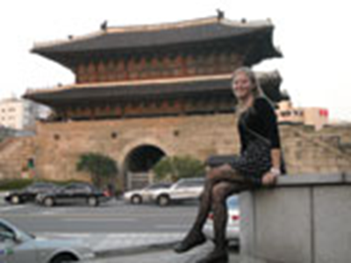
What is Applied Learning?
Categories of hands-on, experiential learning
Research and entrepreneurship
Community service, community engaged learning and research
Study abroad, volunteer abroad, internship abroad
Internships, co-ops, practicums
Parameters
Preparation, Orientation,
& Training
Monitoring & Continuous
Improvement
Reflection & Acknowledgment
Assessment & Evaluation
UAlbany Applied Learning

Slide 3
Benefits of Applied Learning for Our Students
Enables personalized learning
Leads to improved academic performance
Connects and extends theory to practice
Increases student engagement through faculty connections and mentorship
Develops skills including critical thinking, problem solving, decision making, and teamwork
Yields positive professional outcomes including networking, resume building, graduate school skills, jobs, etc.
UAlbany Applied Learning

Slide 4
WHY Applied Learning is Critical to UAlbany’s Strategy
Retention and Recruitment Strategy
Student satisfaction and motivation to learn
Increase Student Success and Engagement
Validates and extends classroom learning
Graduate school and career success
Relationships with faculty, staff and student groups
Strong History of Public Engagement and Partnerships
Presidential stakes
Provost Expertise and Direction
SUNY Central strategy for all campuses
UAlbany Applied Learning

Slide 5
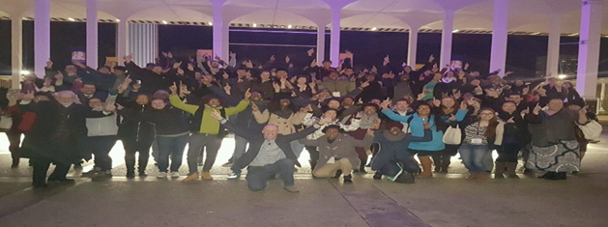
Our Campus has a Strong History in Applied Learning Opportunities
Undergraduate research in departments and via renewed and university-wide emphasis
Departmental, School of Education, and university-wide internship courses
Study Abroad and Service Abroad
Community Service credit-bearing classes (1, 2, and 3 credit options)
Peer Education, Peer Advisors, Peer Career Advisors, Middle Earth Program
Applied learning experiences via campus positions: Residential Assistant, Orientation Leaders, Campus Programming Board, etc.
New, part-time hire in Provost’s Office

Slide 6
Recent Efforts to Accelerate Applied Learning
SUNY Provost Committee on Applied Learning – Linda Krzykowski and Debra Gelinas represent UAlbany
UA Steering Committee formed by Provost – Chaired by Linda Krzykowski (AA) and Noah Simon (SA)
6 Task Forces - Membership available on hand out
Brought a campus team to WACE Institute in June and WACE Assessment Conference in October (World Association for Cooperative Education)
Kick off events
Fall – awareness campaign
Spring – guest speaker
Branding 4 Major Semester Events – Job & Internship Fair, Study Abroad Fair, Service Learning Fair & Undergraduate Research Forum

Slide 7
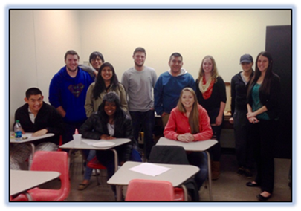
Focused Work in 6 Areas
6 task forces plus Steering Committee work: Members added based on Senate feedback
Baseline Information – Registrar tagging and tracking system
Marketing and Awareness of Applied Learning – created an applied learning experience for our Marketing Research class
Applied Learning Events – kick off event speaker
Faculty Development and Support – support for faculty to attend local course development institute
Assessing Applied Learning – developing toolkits
Credentialing: Merit Pages, micro-credentialing, ePortfolios

Slide 8
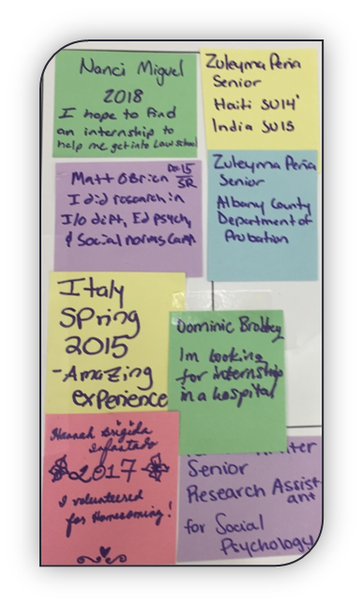
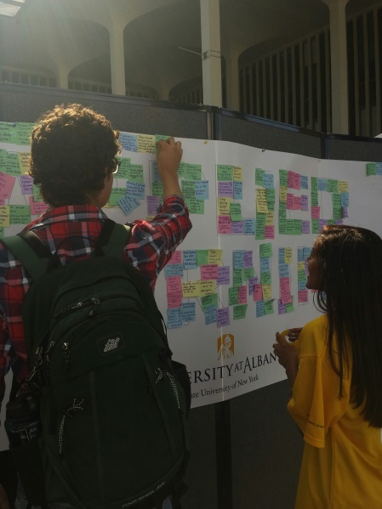
Current Work
Starting to collect data
SUNY-required reports
Increasing Demand
Hosting Events
Marketing Class developing strategies for reaching students
Moving campus jobs to campus internships
Increasing Supply
Connecting with Schools/Colleges
Expanding University offerings
Branding
Give Aways
Tabling at all existing campus fairs and fora
Developing Website-centralized location for information

Slide 9
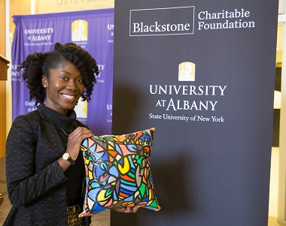
SUNY Report
Part 1 submitted February 15, 2016 (overview of applied/experiential activities)
Parts 2, 3, & 4 due April 15, 2016 (data collection & reporting, faculty engagement, student engagement)
Parts 5, 6, & 7 due May 1, 2017 (feasibility study, collaboration plan, graduation requirement assessment)
UAlbany Applied Learning

Slide 10
Moving Forward
Create Applied Learning culture. Use the term!
Consider building new areas/courses to expand applied learning in schools/colleges/departments
Showcase opportunities that exemplify applied learning
Showcase faculty who are leaders in applied learning
Develop training through ITLAL and encourage faculty involvement
Participate in events/promotions/video about applied learning
Spread a university-wide message to students: participate in applied learning opportunities!

Slide 11
Thank you!
Applied Learning Steering Committee:
Linda Krzykowski, Ph.D., Assistant Vice Provost, Student Engagement, Co-chair
Noah Simon, Director, Office of Career and Professional Development, Co-chair
Jeanette Altarriba, Ph.D., Vice Provost and Dean, Undergraduate Education and Professor, Psychology
Harvey Charles, Ph.D./James Pasquill, Office of International Education and Global Strategy
Ed Engelbride, Ph.D., Associate Vice President, Student Affairs
Richard Fogarty, Ph.D., Associate Professor, History and Associate Dean for General Education
Debra Gelinas, Ed.D., Special Assistant to the Provost for Experiential Education
JoAnne Malatesta, Ph.D., Assistant Vice Provost and Director, Advisement Services Center
Cathy Parker, Associate Director, Office of Career and Professional Development
Debernee Privott, Ph.D., Assistant Dean, College of Arts and Sciences and Director, UHS Program
David Rousseau, Ph.D., Interim Dean, College of Emergency Preparedness, Homeland Security and Cybersecurity
Sheri Stevens, Director, Community and Public Service Program
Douglas Sweet, Coordinator of Student Learning and Assessment, Student Affairs

