Slide 1
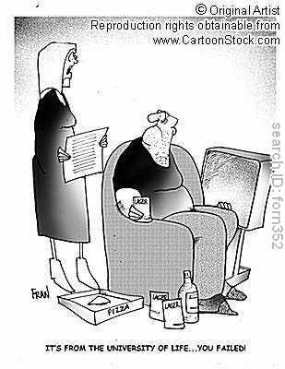

Slide 2
University Life Council: Charge
X.9.2. The Council shall be responsible for the quality of university life outside of the formal instruction program, which is recognized to have significant impact on the overall educational experience. The Council shall recommend policies to the Senate governing university community conditions that affect the overall health, safety and well being of students, faculty and staff. This includes but is not limited to counseling, medical clinical services, financial aid, international student affairs, placement, residence living, student behavior and conduct, student government, athletics and recreation, and services and programs for part-time and emeriti faculty.
X.9.3. The Council shall develop policies and make recommendation to the Senate on matters regarding off campus student life. The Council shall appoint representatives(s) to the Committee on University Community Relations, who shall report back to the Council.
X.9.4. The Council shall take under consideration and make recommendations concerning the operations of the University Auxiliary Services, and other service providers.

Slide 3
University Life Council (ULC) Structure
The Council and Three Subcommittees
Athletics
Residential Life
Health, Safety, and Well-Being

Slide 4
ULC Membership 2010-2011 Daniel R. Leonard, Chair Ex offio: Christine Bouchard, Student Success; Stacy Stern, Finance & Business; Brenda Seckerson, Employee Assistance Program
Teaching Faculty Joanne Carson—Art Dept.
Vishnu Chaturvedi—SPH
Kathleen Dunn—CNSE
Andrew Haas—CCI
Heather Larkin—SSW
Joette Stefl-Mabry--CCI
Professional Faculty
Linda Beliveau—Hlth. Srvcs
Yenisel Gulatee—Advsmt.
Donald Keenan—Libraries
Danielle Leonard—OIE
Colin Quin—Libraries
GSO Representative
Katie Reed
Staff Support—Noah Simon, Career Services

Slide 5
The Committee on Athletics (and Recreation)
X.9.6.1. Composition
X.9.6.1.1. The Director of Athletics, or designee, ex officio
X.9.6.1.2. At least two of the Teaching Faculty members of the IAAB
X.9.6.1.3. At least 4 but not more than 6 Faculty members, including at least 3 members of the Council and at least two Teaching Faculty
X.9.6.1.4. At least 1 but not more than 2 students
X.9.6.1.5. No more than 2 voting members selected from Faculty or Staff who are not students or Voting Faculty.
X.9.6.2. The Committee shall review and make policy recommendations to the Council on athletics programs, including, but not be limited to, intercollegiate and intracollegiate sports programs The committee shall have oversight of policies governing the development and maintenance of education, facilities and resources for recreational physical activity and health maintenance programs for all students and other University members.

Slide 6
The Committee on Health, Safety and Well-being
X.9.5.1. Composition
X.9.5.1.1. The Director of Student Health Services, or designee, ex officio
X.9.5.1.2. The Chief of University Police, or designee, ex officio
X.9.5.1.3. The Director of EAP, or designee, ex officio
X.9.5.1.4. At least 4 but not more than 6 Faculty members, including at least 3 members of the Council and at least one Teaching Faculty member from the School of Public Health.
X.9.5.1.5. At least 2 students, one of whom is resident on campus.
X.9.5.1.6. No more than 2 voting members selected from Faculty or Staff who are not students or Voting Faculty.
X.9.5.2. The committee shall review information on levels and trends, resources and policies for improving university community indicators of mental and physical health, safety and well being of the university community. The committee shall make recommendations to the Council for improving specific programs and overall university community conditions to enhance health and quality of life at the university.
X.9.5.3. The Committee shall appoint members to University safety committees and shall convene special committees to deal with individual safety concerns as needed.

Slide 7
Committee on Residential Life
X.9.7.1. Composition
X.9.7.1.1. The Director of Residential Life or designee, ex officio
X.9.7.1.2. The Vice President for Finance and Business or designee, ex officio
X.9.7.1.3. At least 4 but not more than 6 Faculty members, including at least 3 members of the Council and at least two Teaching Faculty
X.9.7.1.4. At least 1 but not more than 2 students
X.9.7.1.5. No more than 2 voting members selected from Faculty or Staff who are not students or Voting Faculty.
X.9.7.2. The Committee shall review and make policy recommendations on all matters concerning the quality of student life in campus residences, including both academic and co-curricular activities taking place in University residential areas

Slide 8
University Life Council: Past Issues
Examples
Recreational space
Sexual assault legislation and taskforce
Healthcare insurance required for all FT students
No Smoking in residence halls.
Off-campus housing and on-campus housing for graduate students
Emeritus Perks and privileges and space
LGBTQQ Advisory Group Liaison
Undergraduate Omsbuds Office Recommendations

Slide 9
University Life Council 2010-2011
Possible issues to discuss and act upon
Smoking Policy
Recreational Space
On campus Housing and Off-campus housing
Campus Safety
Evaluation criteria for ‘student services’
Will be a much larger discussion

Slide 10
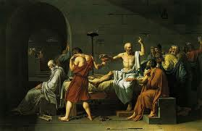
Socrates: “Anything but another senate meeting!”
‘Death of Socrates’: Painting by Jacques Louis David, 1787. Metropolitan Museum

