Slide 1
Graduate Student Association
Wages and Benefits Committee
Presentation to the Senate Executive Committee
Monday, November 3

Slide 2
Introduction
Who we are: The Wages and Benefits Committee has been tasked by the GSA with researching prevailing wage, benefit and graduate student well-being concerns.
We are comprised of funded and unfunded graduate students in MA and PhD programs at UAlbany. We have students from six (6) graduate programs on our Committee.

Slide 3
Timeline
Feb. 17th Meeting with Dean Kevin Williams
Present to GSA Assembly
April 23rd President’s Forum
Meet with Union Reps
Start Research
Fall 2013
Spring 2014
Fall 2014
GSA Assembly Actions:
Fall 2013: GSA Assembly passed resolution supporting $5,000/course for adjuncts at all SUNY schools.
Spring 2014: Voted to have President’s Forum focus on Graduate Wage and Benefit issues.
Spring 2014: SA Assembly voted to endorse $5,000/course for adjuncts at all SUNY schools.
Fall 2014: Voted for GSA Wages and Benefits Committee to present research findings to the University Senate.

Slide 4
How we collected research:
Reviewed all research and reports available on the Institutional Research webpage
Met with Dean Kevin Williams on February 17, 2014
Held meetings with campus unions
Addressed the GSA Assembly and asked for feedback
Presented questions at the Spring 2014 President’s Forum
Informally polled graduate students in our departments
(for qualitative information on student experiences)

Slide 5
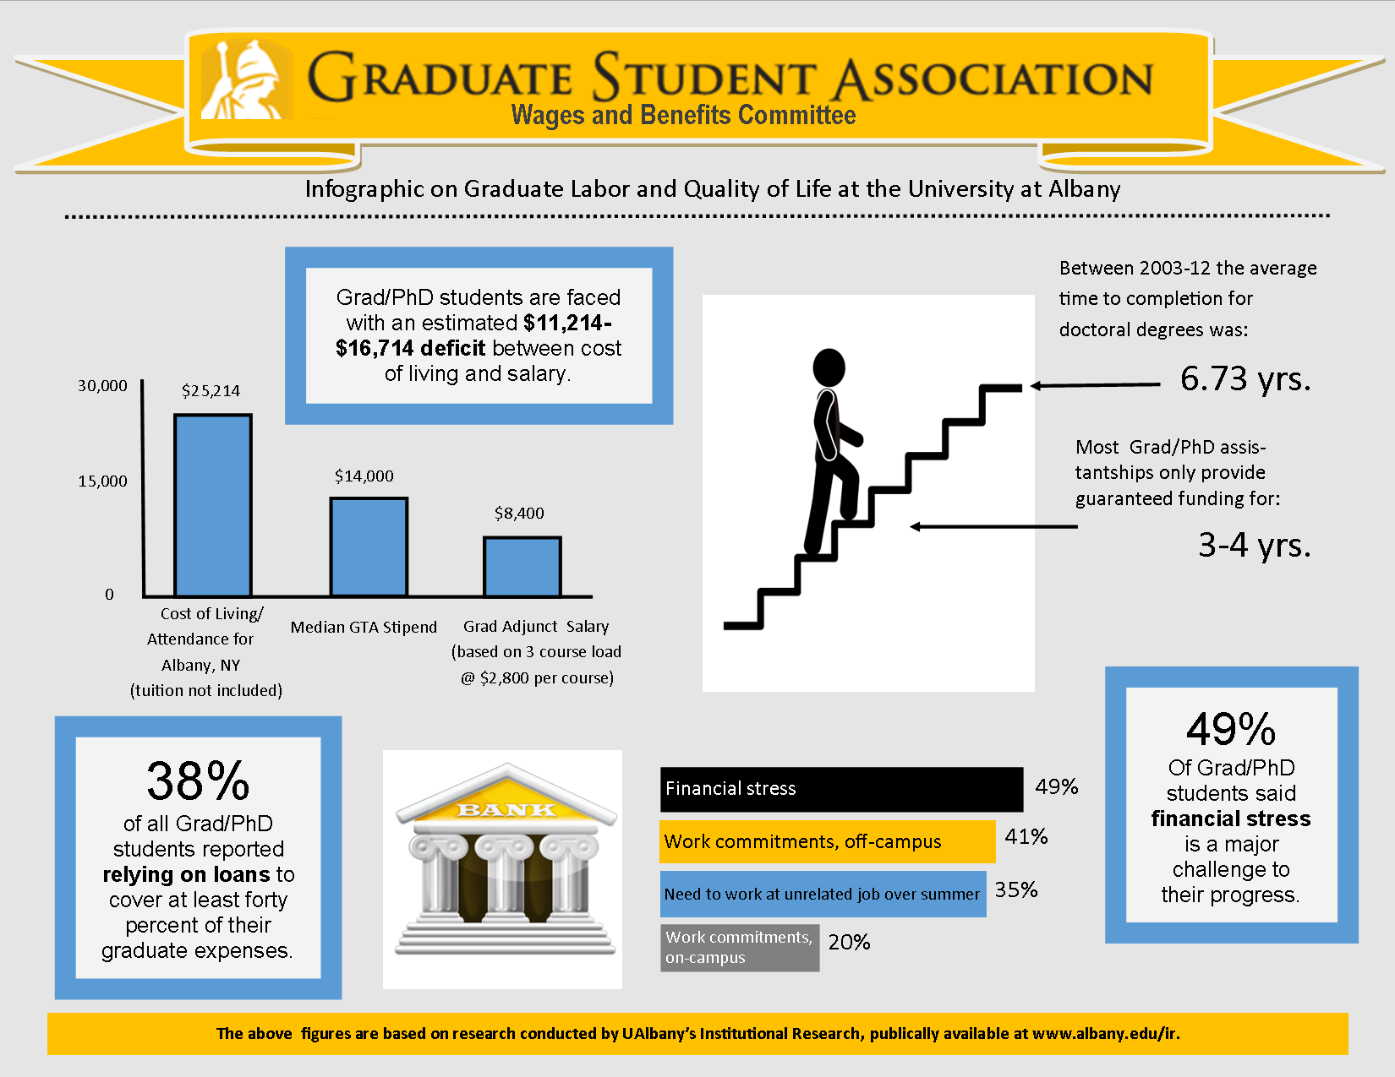

Slide 6
Research Findings
1. Financial Stress is a significant impediment to degree progress and has negative impacts on mental and physical health, as well as quality of life.

Slide 7
Research Findings
2. Funding and Financial Support is not sufficient (it is below the cost of living) and does not match the reality of graduate students’ lives.

Slide 8
Research Findings
3. Heavy reliance on Loans and Credit to pay for education contributes to financial stress and anxiety about the future.
Nationally:
40% of the $1 trillion in outstanding student loans financed graduate and professional degrees
Graduate students owe an average of $57,600
One quarter of graduate students borrow around $100,000; 1 in 10 over $150,000
Federal Education Budget Project at New America

Slide 9
Research Findings
4. Professional Development varies widely by department. Some Departments direct resources toward training graduate students to be competent researchers and educators, others do not.
5. Communication about Workplace Conditions and Rights varies widely by department. Some students were not aware of work expectations, hours, length of contract, or potential for future funding.

Slide 10
Quotes from Graduate Students
“I currently work as a research assistant … a job for which I am grateful but also does not allow me to make ends meet in spite of the 20 hours per week I am allowed to work. I’ve had to take up a second job on weekends, putting me at 36 hours of work a week while going to school full time and still barely making enough to pay rent and put food on the table every month, and STILL I am $10,500 in debt for this term.”
“I have $72,000 of debt, $6,000 of that is interest, and I have lived the last 6 years of my life in poverty. I have no idea how I’m going to pay that debt off especially given the fact that full-time, tenured track job prospects are dwindling. There is no guarantee that a PhD will help you earn more, but I made a $72,000 bet, I really hope it pays off.”
“I was a funded student when I began my Ph.D. I was guaranteed 4 years with an optional 5thyr (which never came). At the end of my 4 years, it felt like I had the rug pulled out from under me. It’s not like what I was getting paid during the 4 years was enough to live off by any means, I had to work an additional 20-30 hours on the side of teaching and taking classes full time, which isn’t permitted (although many of my colleagues have to work additional minimum wage positions to be able to live) but going from some money to very limited money ($2,500 a semester as an adjunct) which doesn’t even come on time, no stability and no benefits during such an important part of my Ph.D. process was extremely stressful and made me really question academia and this University’s and my departments relationship with its graduate students.”

Slide 11
Quotes from Graduate Students
“Over $100,000 in debt as a funded student, no stability, no family support, no department support, and no real prospects because the academic job market is crashing, and my department doesn’t seem to care enough to really advise students. Meanwhile a new football field is built, fountains are being renovated, and new administrators are being hired left and right.”
“Because I currently serve as a GA on a grant funded project, rather than as state-line GA, I am being prevented from teaching next semester based on pressure from grad studies office to not give extra service to GA's. In addition to the financial implication, I am missing out on professional development experience that is essential for seeking an academic job.”
“I am not funded, I have two jobs in order to pay for part-time enrollment. Many of my classes are taught by adjuncts or graduate instructors and my tuition is going up every year. It’s frustrating to keep paying more each year for an education that seems to be decreasing in quality.”

Slide 12
Recommendations- financial support
Advocate for expansion of financial support for Graduate Students at all levels (unfunded, GTA, adjunct).
Reconsider length of funding to match average time to completion (6.7yrs).

Slide 13
Recommendations- financial support
Advocate for the reduction or elimination of fees for graduate students.
Outline department’s financial commitment and time to completion data for each new student.

Slide 14
Recommendations- representation and information
Conduct more research on how UAlbany graduate and adjunct salaries compare to peer institutions/depts.
Include graduate students in workplace decision-making.
Build in overview of contract policies and workplace rights into departmental orientations.
Build in financial planning into advising and have an understanding of each student’s financial situation.

Slide 15
Recommendations- advocacy
Advocate for campus, state and national policies that improve quality of life and education for graduate students without raising tuition, fees, increasing debt burdens or undermining working conditions.

Slide 16
Conclusion
Questions or Discussion

Slide 17
END OF PRESENTATION
The next few slides are extra info, will not be included in full presentation.

Slide 18
Examples
SUNY Stony Brook: “ Effective fall 2009, a full assistantship has a minimum value of $15,145 for the academic year. ”

Slide 19
National and Statewide Context
National Policy:
Budget Control Act of 2011: “Effective for loans made for periods of enrollment (loan periods) beginning on or after July 1, 2012, graduate and professional students are no longer eligible to receive Direct Subsidized Loans.”
State Policy:
NY SUNY 2020: “Effective for loans made for periods of enrollment (loan periods) beginning on or after July 1, 2012, graduate and professional students are no longer eligible to receive Direct Subsidized Loans.”

Slide 20
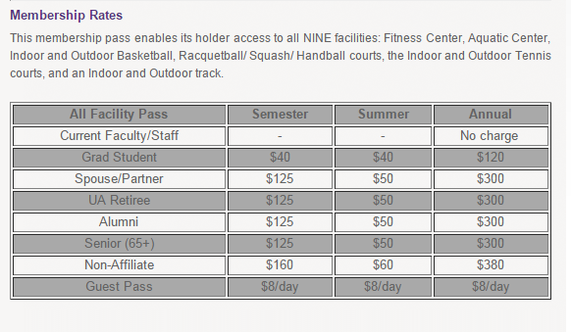
Campus Policies
Fall 2008: UAlbany eliminates on-campus housing for Graduate students
Graduate Students are only campus members who are charged gym fee ($120/yr)

