Slide 1
SIP Endorsement of other organizations
Friday, May 12, 2017

Slide 2
36
Total Responses
Date Created: Sunday, May 07, 2017
Complete Responses: 32

Slide 3
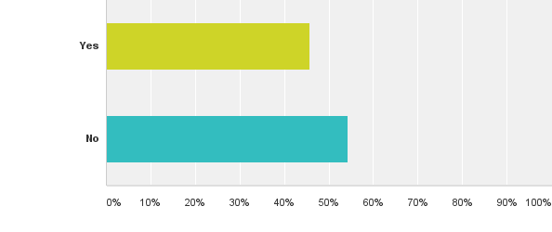
Q1: Do you think SIP, as an organization, should endorse people running for offices in other organizations?
Answered: 35 Skipped: 1

Slide 4
Q1: Do you think SIP, as an organization, should endorse people running for offices in other organizations?
Answered: 35 Skipped: 1

Slide 5
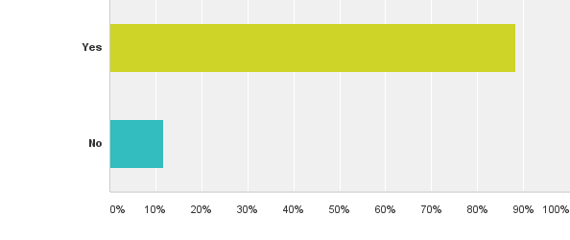
Q2: Do you think SIP members, as individual members, should endorse people running for offices in other organizations?
Answered: 34 Skipped: 2

Slide 6
Q2: Do you think SIP members, as individual members, should endorse people running for offices in other organizations?
Answered: 34 Skipped: 2

Slide 7
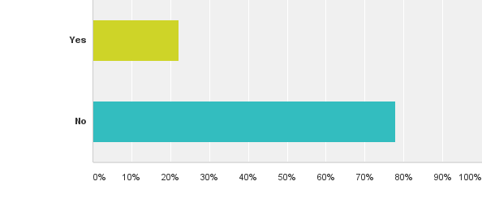
Q3: Are you a student?
Answered: 36 Skipped: 0

Slide 8
Q3: Are you a student?
Answered: 36 Skipped: 0

Slide 9
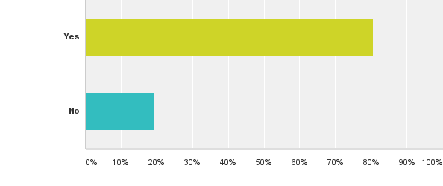
Q4: Are you a tribal member?
Answered: 36 Skipped: 0

Slide 10
Q4: Are you a tribal member?
Answered: 36 Skipped: 0

