Slide 1
Women in Higher Education: Next Steps
November 26, 2018

Slide 3
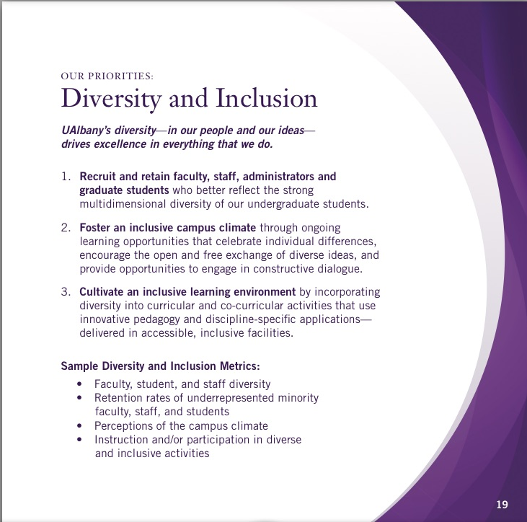

Slide 4
Objectives
Provide opportunity for diverse group of UAlbany women to reflect on issues, challenges, and opportunities for women within our campus community.
Cultivate engagement of these colleagues as partners in realizing our strategic priorities, particularly Diversity and Inclusion.
Position the experience of women as a critical measure of success within Diversity and Inclusion.
Identify specific initiatives and actions that could move the needle in these areas while helping to fulfill our mission and reach our vision.
Build experience and capacity as an institution for future conversations that enhance communication and engagement by intentionally viewing this meeting as a prototype.

Slide 5
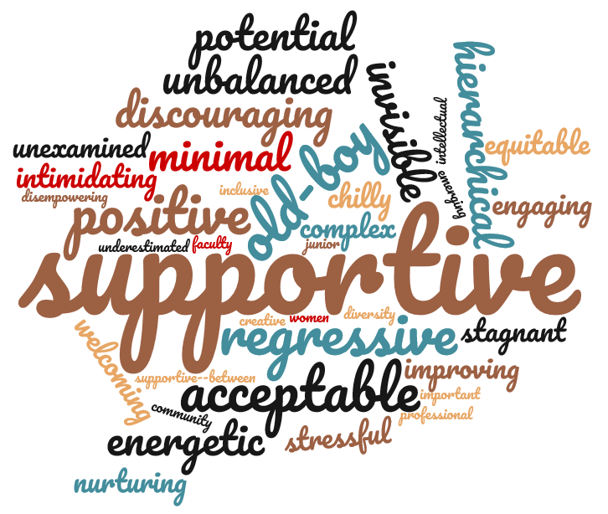
Provide three words to describe the campus climate for women at UAlbany:

Slide 6
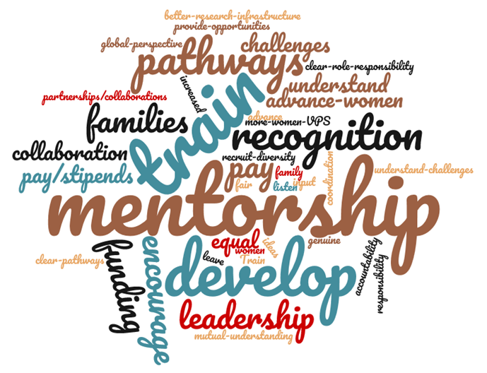
How can UAlbany help me reach my goals?

Slide 7
How can I help UAlbany meet its strategic priorities?

Slide 8
Table Initiatives
Table 1: Rotational Training Program for Students, Faculty, and Staff. Provide a rotational program that offers women an opportunity to work in different areas of the University.
Table 2: Dialogue Series for Women. Create a dialogue series for women that could address many topic areas (such as: FMLA, professional development, higher education, mentorship, etc.).
Table 3: Salary Equity Study. Research salary equity at UAlbany, perhaps focusing on comparisons to other SUNY institutions.
Table 4: UAlbany Women’s Leadership Institute. Provide training, mentoring, and networking for female students, faculty and staff.
Table 5: Design a University-based professional development and training program for women—and remove Rank Restrictions from Promotions to Leadership Positions.
Table 6: Review of Policies, Practices and Procedures to Assure Equity. Review institutional practices, policies and procedures (such as the Family Leave Policy, Stop the Clock, Family Leave Policy, hiring/promotions).

Slide 9
Initiatives for Discussion Today
1. A Women’s Leadership Institute to address mentorship, professional development and rotational leadership opportunities, leadership development, networking and a dialog series.
2. A Review of Policies and Practices to address concerns such as salary and service equity, Family Medical Leave, and “Stop the Clock” tenure policy.
3. Hosting a major conference relating to Women in Higher Education, with scope and focus TBD

