Slide 1
University Senate November 13th 2017
Campus Governance Leaders & Council and Committee Chairs
Please sign in
Pick up your assigned iClicker
Take a seat in the front
Senators:
Please sign in
Pick up your assigned iClicker
Take a seat in the chairs angled toward the center
Guests:
Please sign in
Take a seat in the chairs towards the back of the room

Slide 2
Agenda
Approval of Minutes of Oct 16th, 2017
Provost’s Report – Ann Marie Murray Assoc. Provost Program Development
Senate Chair’s Report –Karin Reinhold
Other Reports:
SUNY Senators’ Report
Graduate Student Association Report
Undergraduate Student Association Report
Council/Committee Reports
New Business:
Gina Volynsky, Director of the SUNY’s CID
MS/PhD Program in Electrical and Computer Science Engineering
Global Distinction milestones
Charter amendment announcement for ULC
Approval of changes in Council membership
Announcements
Adjournment

Slide 3
Approval of Minutes October 16th, 2017

Slide 4
Provost’s Report
Associate Provost for Program Development Ann Marie Murray,
on behalf of Provost James Stellar

Slide 5
Senate Chair’s Report –Karin Reinhold
II. Actions taken
MS & PhD in Electrical and Computer Science Engineering was sent to SEC for approval for the November 13th Senate meeting.
Global Distinction proposal was also sent to SEC for approval for the November 13th Senate meeting.
Charter amendment - 1718-01A Amendment of sections X.9.1.3, 9.1.7, 9.1.8, 9.2 & 9.6 of ULC - was approved by SEC to be presented at the November 13th Senate meeting.
III. Recommendations for actions
Resolutions adopted by the SUNY Plenary were sent to councils for consideration.
The proposal for discontinuation of the combined BA/BS/MS with the MBA programs is being considered by UPPC.
The MA in International Education Management was sent to UPPC

Slide 6
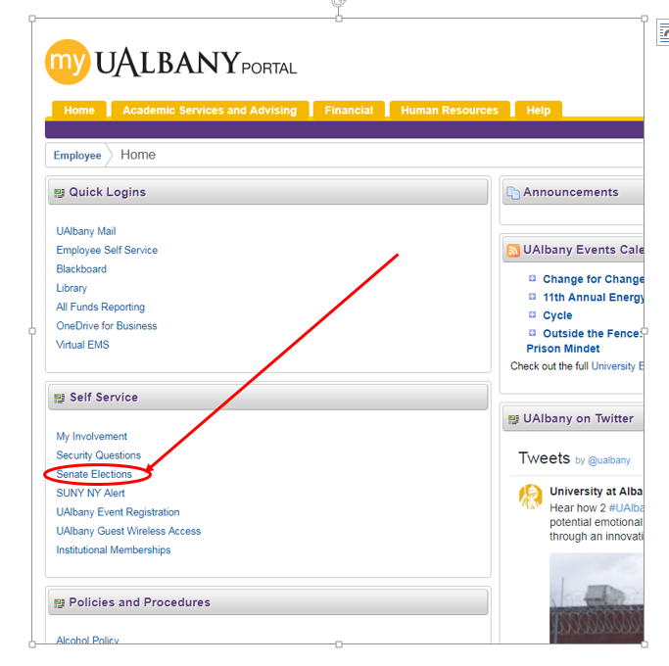
Senate Chair’s Report –Karin Reinhold
IV. Announcements
Vote for amendments to bylaws 1718BA01 & 1718BA02 started on Nov 7th.
PLEASE VOTE:
MyUAlbany -> Home ->
Self Service -> Senate Elections

Slide 7
Senate Chair’s Report –Karin Reinhold
IV. Announcements
Vacancies in Councils and subcommittees: UPPC has vacancies in
Resource Analysis and Planning Committee
University Facilities Committee
The UFS requests articles about higher education issues, to be published in the UFS Bulletin.
2017 SUNY Diversity Conference: Engaging Equity, Diversity and Inclusivity in the Classroom, Campus and Community, Nov 29th - Dec 1st .

Slide 8
Senate Chair’s Report –Karin Reinhold
V. Three Things for all Senators
IMPORTANT: Encourage your department/unit’s faculty and professionals to VOTE for the Amendment to the Bylaws 1617BA01 Right of contingent faculty to vote for their own representative, and 1617BA02 Definition of Quorum for Senate Meetings.
The Conversation, theconversation.com, welcomes articles by faculty.
Ask your department what was learned about the Implicit Bias Training from this past week.

Slide 9
UFS (University Faculty Senator’s Report) – Diane Hamilton, Walter Little, and Latonia Spencer
Nothing to report

Slide 10
Graduate Student Association Report Dawn Wharram, GSA Lead Senator
Nothing to report

Slide 11
Student Association Report Jerlisa Fontaine, President
Nothing to report

Slide 12
CAA Istvan Kecskes, Chair, Mary Ellen Mallia Co-Chair
Nothing to report.

Slide 13
CAFFECoR – Carol Jewell, Chair
Nothing to Report

Slide 14
CERS – Michael Jerison, Chair
David Wagner nominated Chair

Slide 15
COR –Robert Rosenswig, Chair
Nothing to report

Slide 16
CPCA – Louise Anne McNUtt, Chair
Nothing to report

Slide 17
GAC – Sean Rafferty, Chair
Nothing to report

Slide 18
GOV –Jim Mower, Chair
GOV has recently searched for a replacement for the MyUAlbany voting utility with the hope that an easier-to-use system might be found that could enhance voter turnout. A potential substitute, ballotbin.com, was investigated but was found to lack robust security features for auditing and voter registration. The GOV Committee on Liaison and Elections (CLE) is preparing to search for other alternatives and will prepare a report by the end of the fall semester.

Slide 19
LISC –Billie Franchini, Chair
Nothing to report

Slide 20
UAC –Christy Smith, Chair
UAC discussed the announcement SUNY is updating its General Education requirements; a white paper is expected a year from now. It will include Information Literacy core competencies for all of SUNY.
The Subcommittee on Academic Standing is working on a policy that will limit student proposals to ask for course drops after the withdrawal deadline to one year;
The Fall SUNY Plenary held at Delhi October 19-21 included a resolution for Academic Advisers related to financial aid. Chair Reinhold has asked UAC to investigate the problem at UA and what we are doing to protect both faculty and students when negotiating increasingly complex rules and regulations (eg TAP and Excelsior) that can affect a student’s ability to receive financial aid.

Slide 21
ULC –Ekow King, Chair
Chantelle Cleary, JD Asst. Vice President for Equity and Compliance discussed the University’s coordinated response for cases that include discrimination, sexual violence, harassment, Title IX, title VII, ADA or any other protected basis
ULC discussed the University’s Strategic plan for Diversity/Inclusion request to Tamara Minor.
VP Jim Van Voorst gave the council some information regarding the status of the Interfaith Center.

Slide 22
ULC –Ekow King, Chair
Reports of Actions
Community and Ex-Officio updates added to the ongoing agenda (also included in the ULC amended charter)
Reviewed ULC Charter amendments and additional changes prior to introduction to SEC at upcoming meeting. Revisions were approved.
Recommendations for Actions
ULC is working on Affordable Childcare Resolution
ULC is working on Resolution regarding Indigenous People’s Day
ULC will consider resolution regarding the Interfaith Center

Slide 23
UPPC –Jim Collins, Chair
The Provost responded to questions about the status of Information Science Department and its new location within the College of Emergency, Homeland, and Cyber Security of Actions
VP for Finance and Administration J. Van Voorst reported from the capital and operations budget
Joette Stefl-Mabry, the Council’s representative to the University’s Assessment Advisory Committee, reported that the committee had met three times since mid-summer and was, in her view, doing very good work.
Actions:
The Council confirmed its support for the Center for International Education and Global Strategy proposal for a Global Distinction Milestone.
The Council declined to review Senate Bill 1718-01, Proposal to Establish M.S. and Ph.D. Programs in Electrical and Computer Engineering, and referred the proposal to the SEC.

Slide 24
New Business:
A. Gina Volynsky, Director of the SUNY’s Center for International Development

Slide 25
New Business:
B. Bill 17818-01: Proposal to establish
MS/PhD Program in Electrical and Computer Science Engineering

Slide 26
New Business:
C. Bill 17818-02: Proposal to establish
Undergraduate Global Distinction Transcript Milestones

Slide 27
New Business:
D. Charter Amendment Announcement
1718-01A Amendment of Sections
X.9.1.3, 9.1.7, 9.1.8, 9.2 & 9.6
of ULC

Slide 28
New Business E. Approval of changes in council membership
CERS:
Marina Petrukhina - Chemistry
Richard Goldstein - Mathematics
CPCA

Slide 29
Announcements
PLEASE VOTE & encourage colleagues to vote for the Bylaws Amendments. Nov 7 – Dec 5

Slide 30
Adjournment
Other Business?

